Slide 1

Mesonet Updates
Daryl Herzmann
@akrherz
28 September 2022

Slide 2
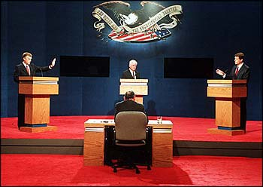
Who am I and Why am I here?
Hi I’m daryl! I’m staff in Agronomy with a BS in Meteorology.
I’m the proprietor of the IEM website.
All y’all are supposed to be directly in my wheelhouse for website users to support!
I was told there was free food.
AP Photo

Slide 3

What is going on here? https://mesonet.agron.iastate.edu
For past 21 years, I’ve implemented about 95% of the requests made of me for weather / climate products + data.
Unmitigated website feature sprawl with ~150 apps, ~30 download portals, and ~230 automated plotting apps.
To atone for these sins, I promptly answer all the emails I get. (GOTO step 1)

Slide 4

Horrible Self Own. So I need to spend an hour with a Powerpoint to explain how to use a website in the year 2022?

Slide 5
30,000 foot view of IEM
Other states have a University/State “Mesonet” with staff (gasp), deployed equipment, and research programs.
ISU has a “Soil Moisture Network”, which is a quasi mesonet, some call it the mesonet, but it is not what the IEM is!
Data from the Soil Moisture Network is found on the IEM website, along with everything else under the sun! To make things fun and confusing.

Slide 6

Augh daryl! I just want to know how much it rained and if we are above or below average for GDDs.
Tenor.com

Slide 7
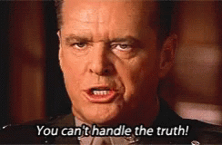
TELL ME RAINFALL AND GDDs!
Do you know what you are asking for?
What is average/normal, are they even the same?
What are your accuracy requirements?
What variability are you attempting to explain?
Tenor.com
Speaking of Variability….

Slide 8
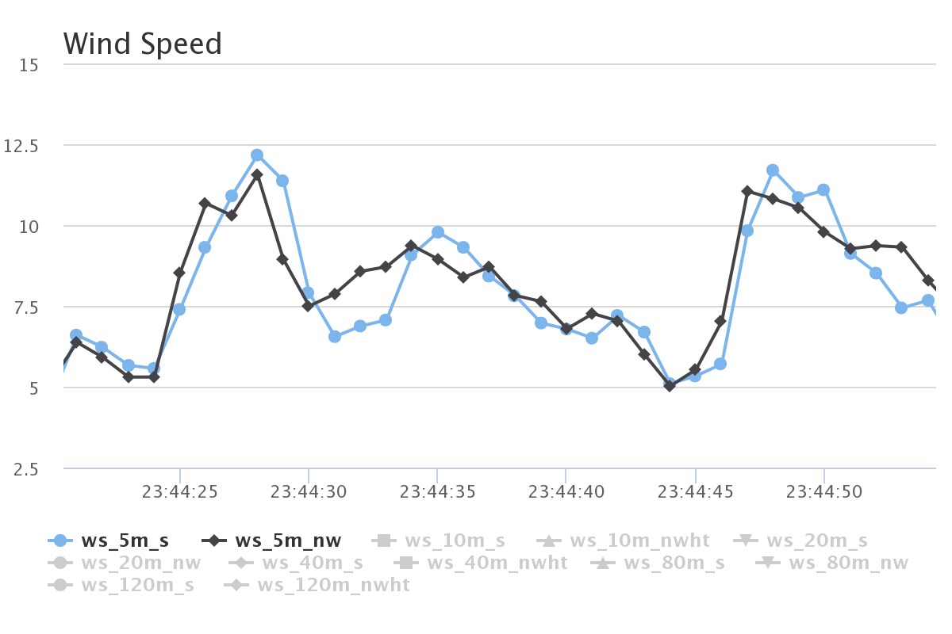
ISU “Tall Towers” 1 second interval Wind Speed [mps]
This entire plot is just 1 minute of data!
Two sensors at same height, mounted at different directions on the tower. We also have 20 Hz data ☺

Slide 9
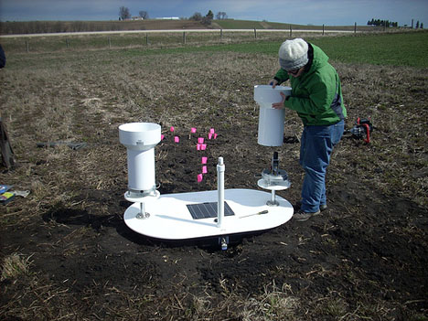
Precipitation Variability
Iowa Flood Center experiment with tipping buckets 3 feet apart
Found some cases of noticeable differences between these two gauges
In general case, which gauge is right? ☺
http://iowafloodcenter.org/notes-from-the-field-rain-gauges/

Slide 10
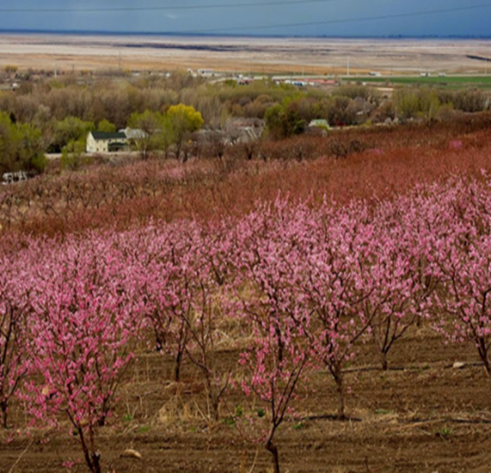
Temperature Variability
Subtle topography / elevation changes make a difference!
Similar to wind, one second plots sometimes show rapid temperature fluctuations
Urban Heat Islands impact temperature representativity
Photo: Dr Elywnn Taylor

Slide 11
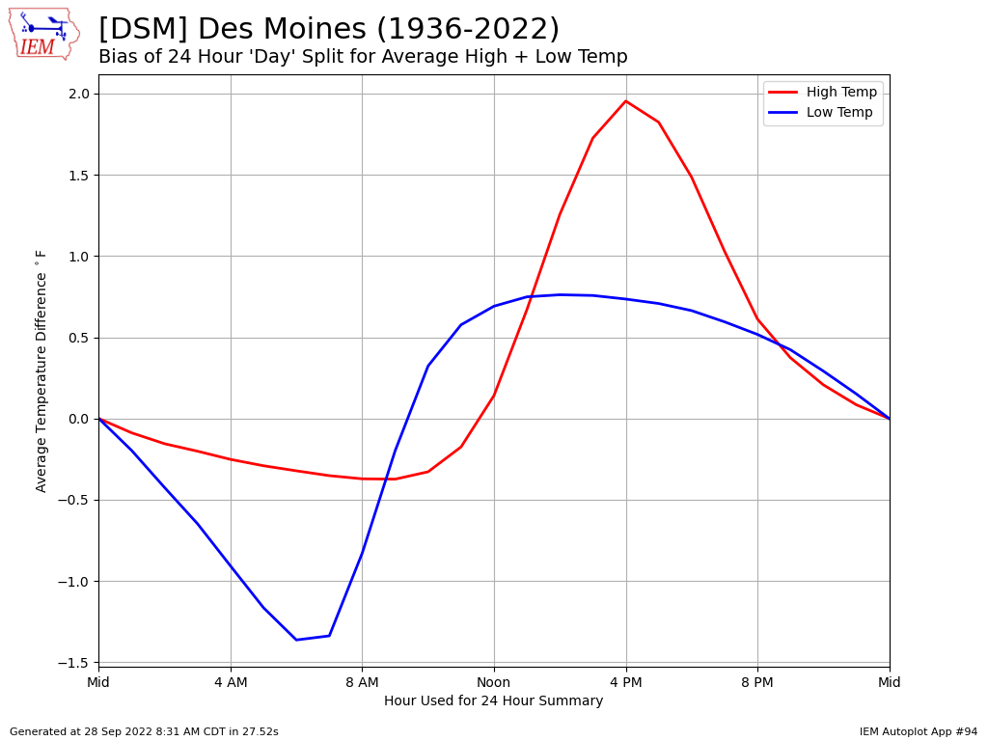
Web Link #94

Slide 12
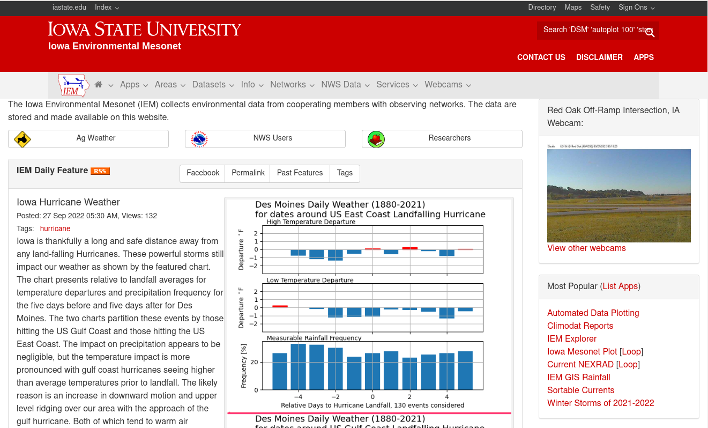

Slide 13
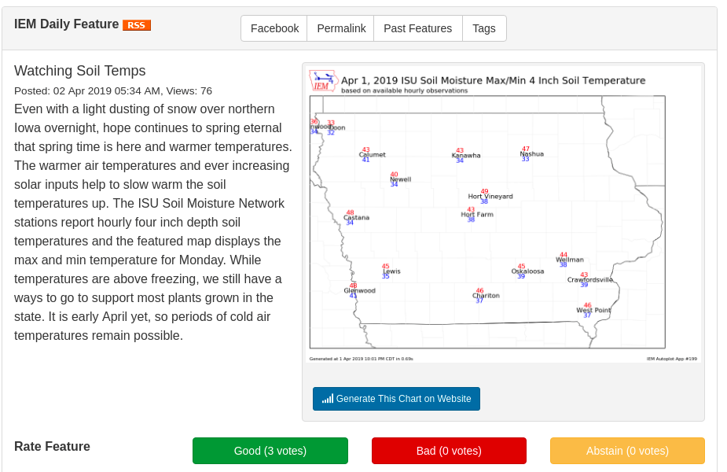
Plugging my IEM Daily Feature
Highlights something hopefully relevant each day
RSS Feed if you don’t want to check website daily, also view past features
Often links to IEM app that generated the plot, so you can tweak, download raw data

Slide 14
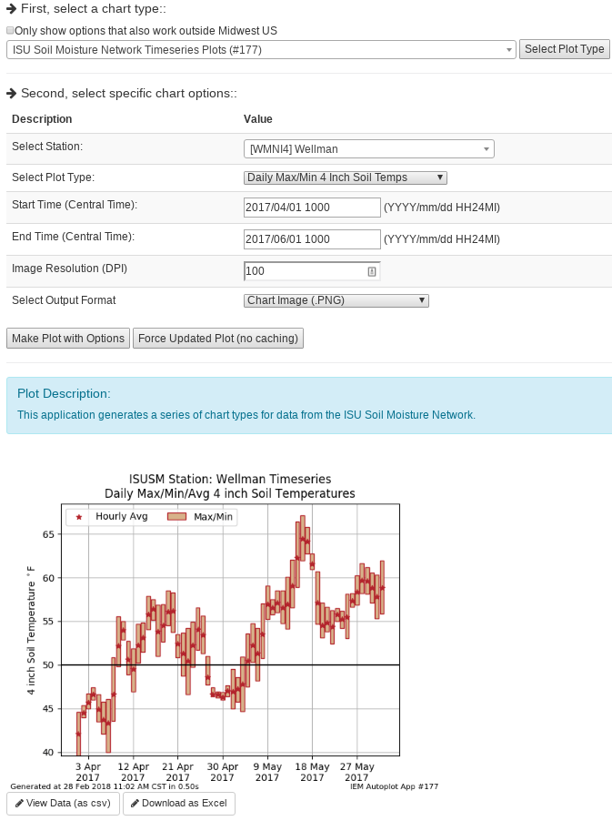
IEM Auto Plotting
Select Plot Type
Select Plot Options
Description
Custom Generated Plot
Download Raw Data (Excel)

Slide 15
Which network should I use?
Data Need | Recommendation
“Daily” High/Low Temps + Precipitation | NWS COOP IEM “Long Term Climate” / “Climodat”
Wind | ISU Soil Moisture ASOS / AWOS (Airport weather stations)
Solar Radiation | ISU Soil Moisture
Hourly Rainfall, not snow | ISU Soil Moisture / ASOS / AWOS
River Stage | DCP (USGS gauges)
Soil Temperature/Moisture | ISU Soil Moisture / SCAN
Humidity | ISU Soil Moisture / ASOS / AWOS
Pavement Temperatures | RWIS

Slide 16
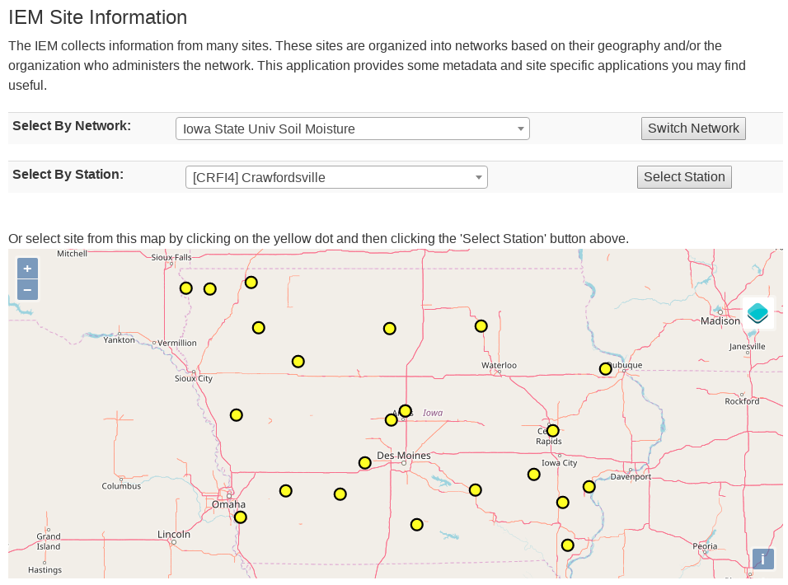
How do I find my closest station within a given IEM network?
IEM -> Info Tab -> Station Data + Metadata

Slide 17
Some Weather Variables to Monitor
Growing Degree Days
Temperatures
Soil Moisture/Temperature
Precipitation
Wind

Slide 18
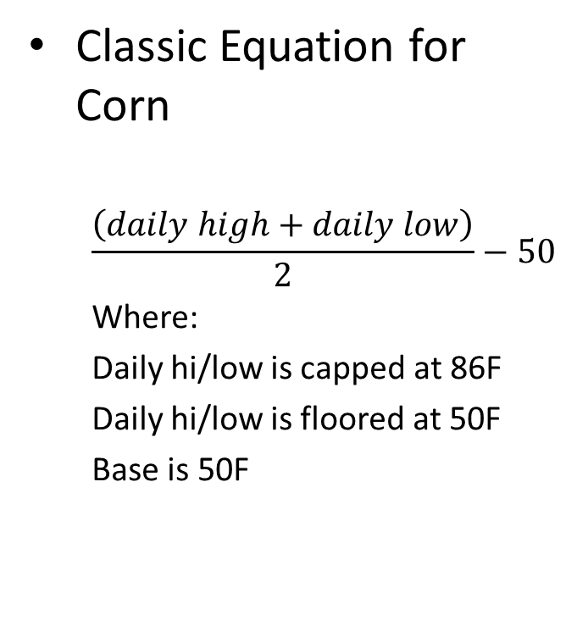
What are Growing Degree Days (GDD)?
Classic Equation for Corn
$$\frac{\left(daily high+daily low\right)}{2}−50$$
Where:
Daily hi/low is capped at 86F
Daily hi/low is floored at 50F
Base is 50F
Example 1
High 90
Low 48
GDD: (90 86 + 48 50)/2 – 50 = 18
Example 2
High 40
Low 32
GDD: (40 50 + 32 50)/2 – 50 = 0

Slide 19
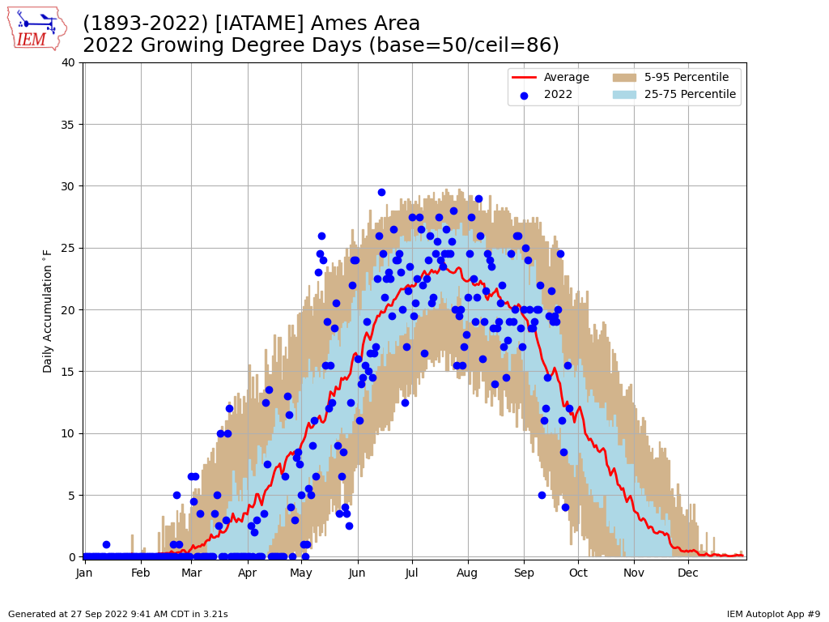
Web Link #9

Slide 20
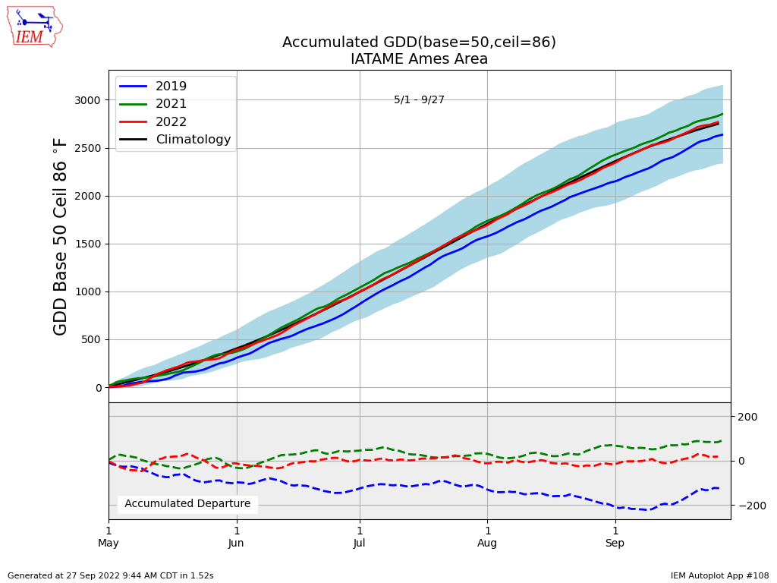
Web Link #108

Slide 21
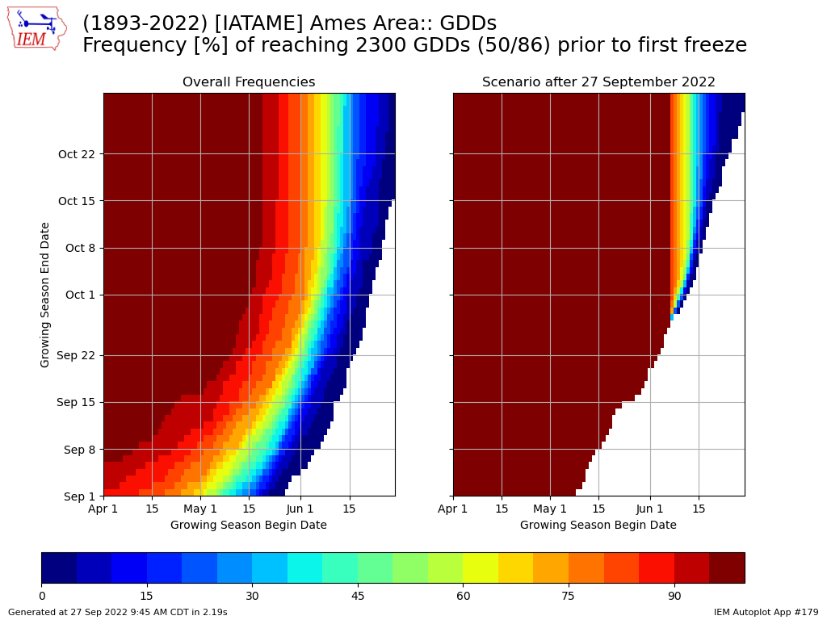
Web Link #179

Slide 22
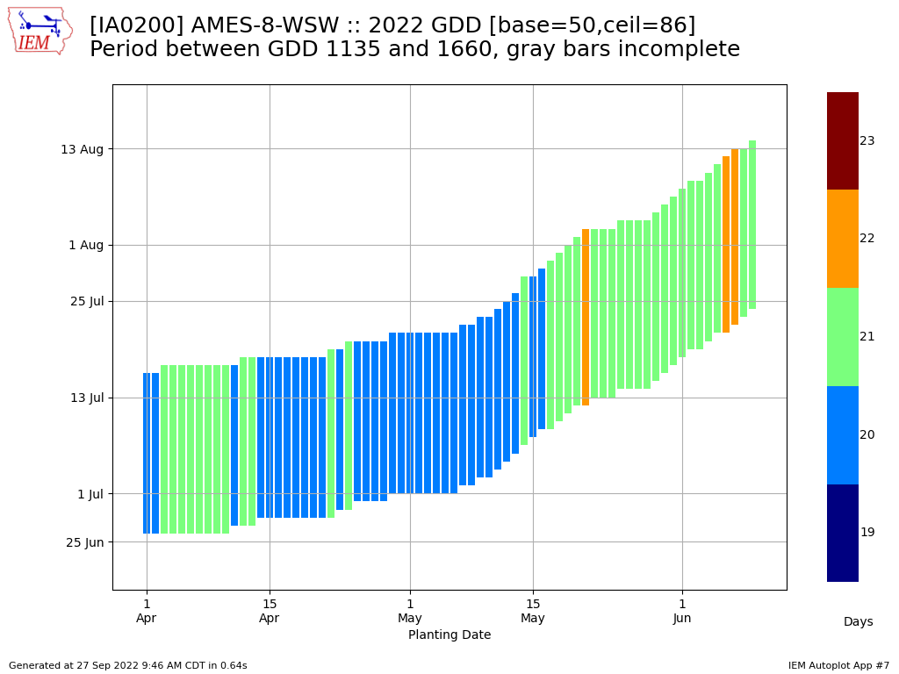
Web Link #7

Slide 23
Some Weather Variables to Monitor
Growing Degree Days
Temperatures
Soil Moisture/Temperature
Precipitation
Wind

Slide 24
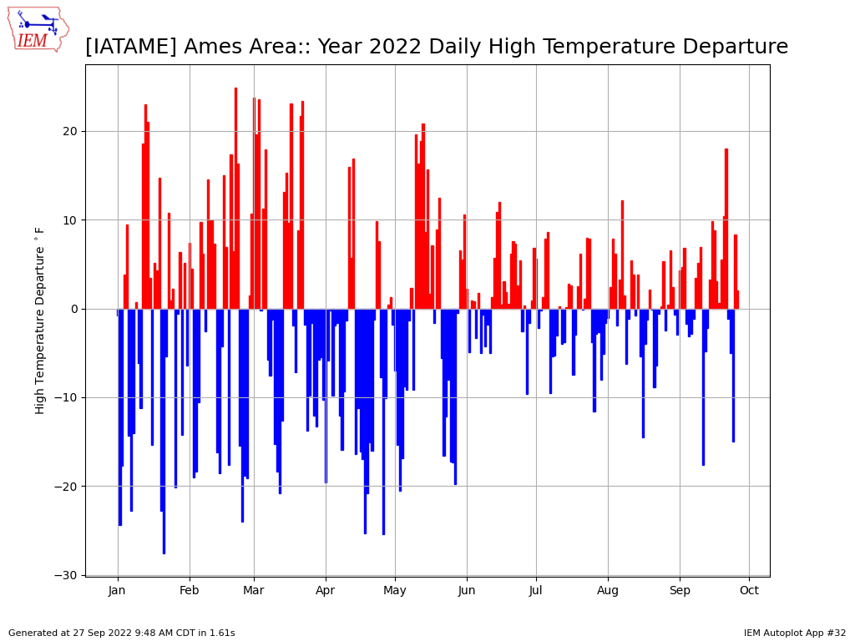
Web Link #32

Slide 25
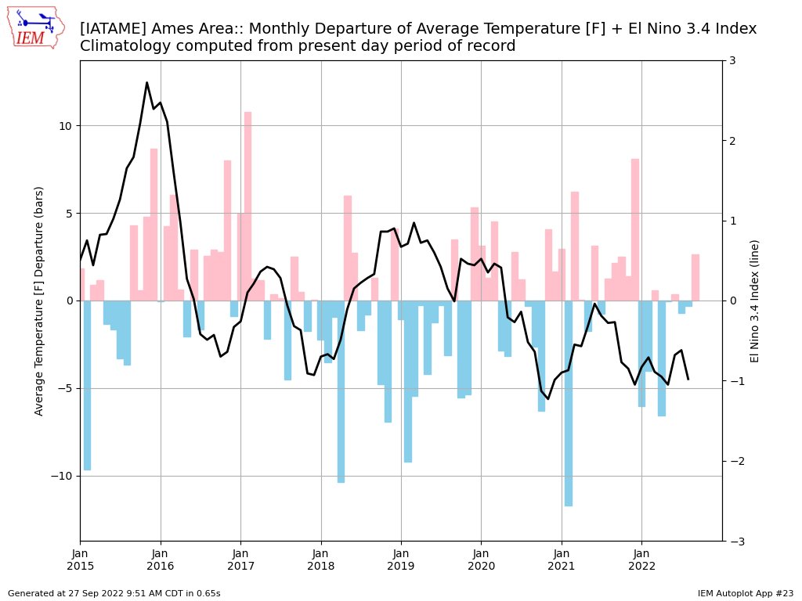
Web Link #23

Slide 26
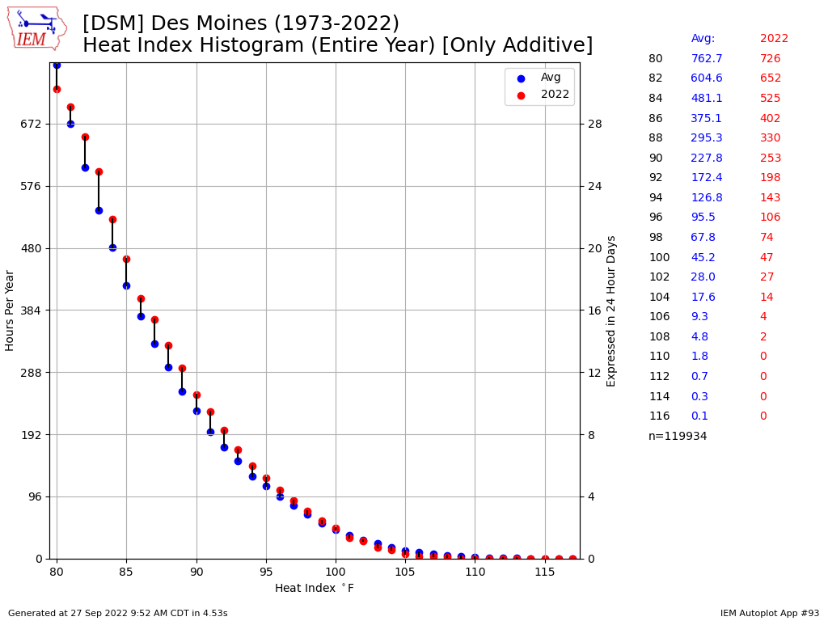
Web Link #93

Slide 27
Some Weather Variables to Monitor
Growing Degree Days
Temperatures
Soil Moisture/Temperature
Precipitation
Wind

Slide 28
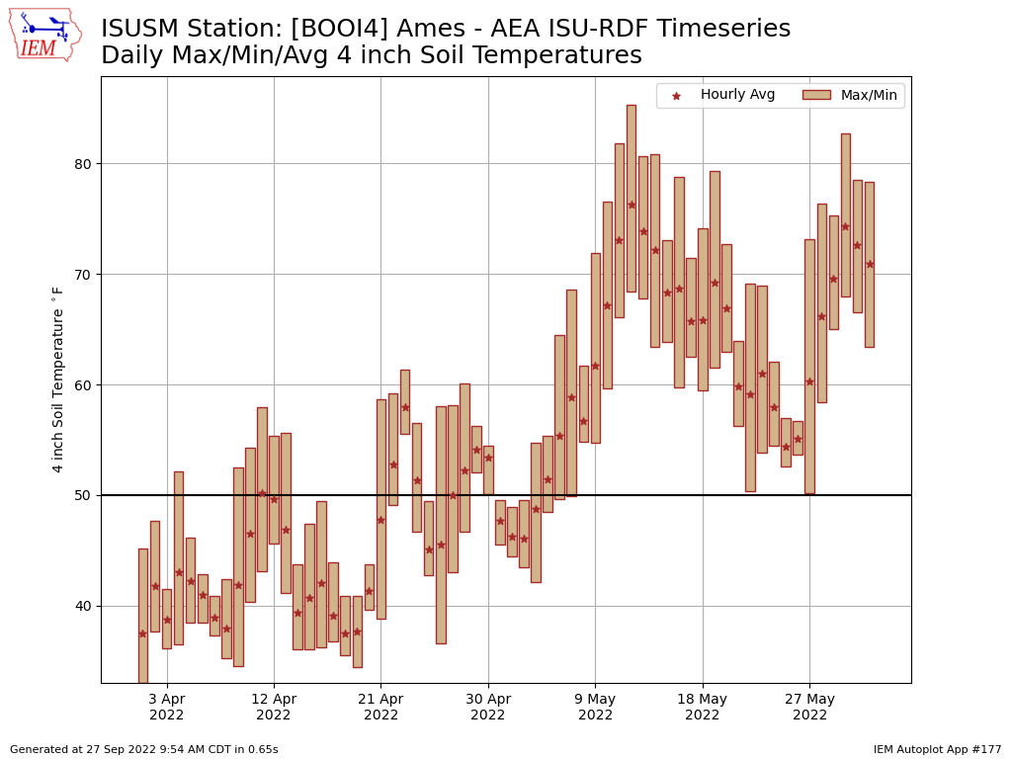
Web Link #177

Slide 29
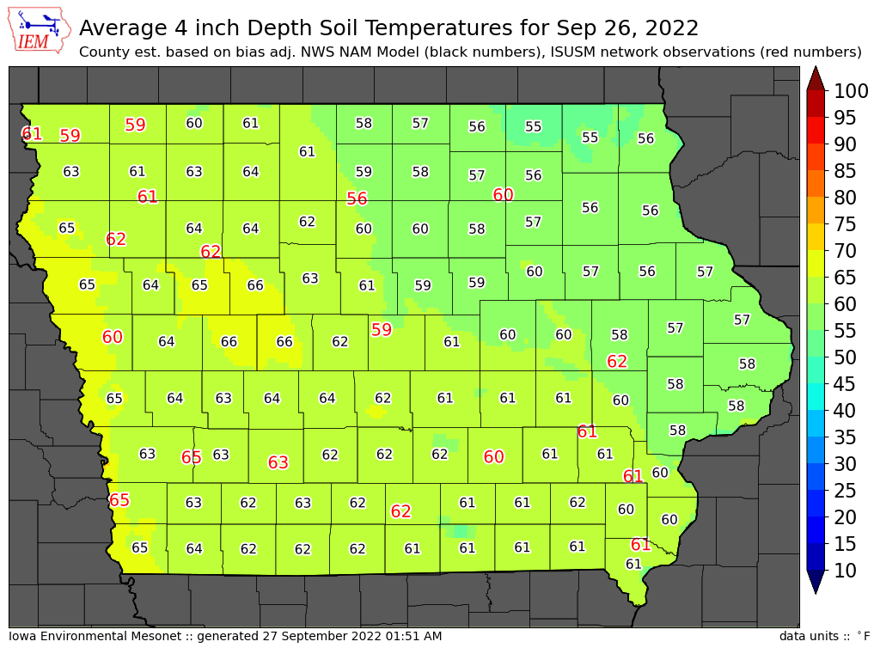
Web Link

Slide 30
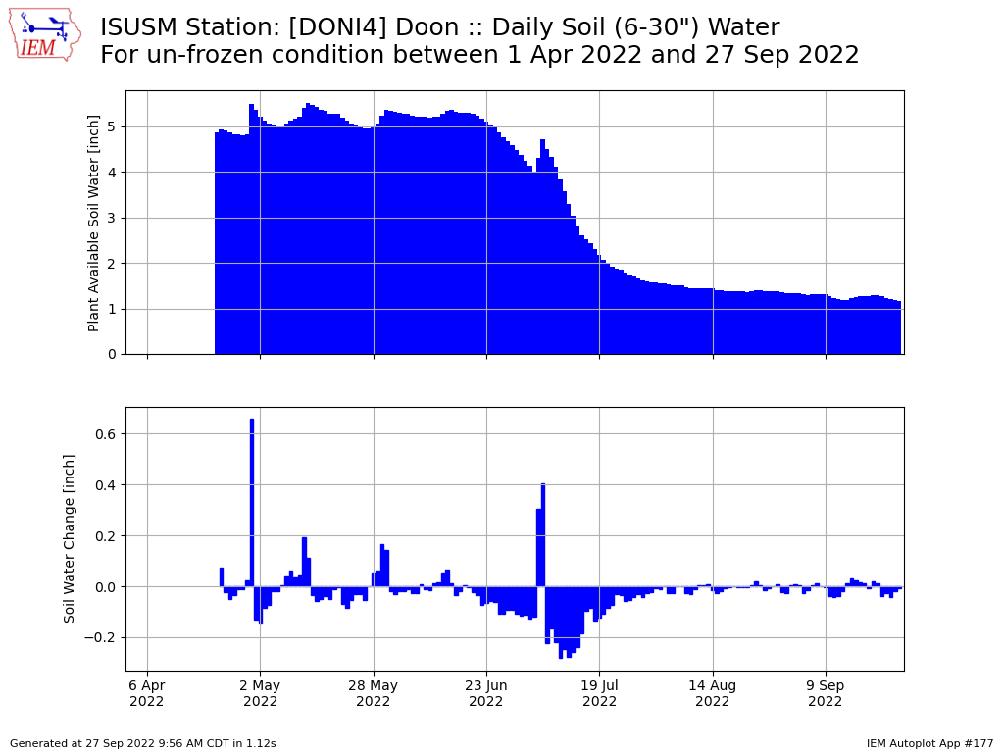
Web Link #177

Slide 31
Some Weather Variables to Monitor
Growing Degree Days
Temperatures
Soil Moisture/Temperature
Precipitation
Wind

Slide 32
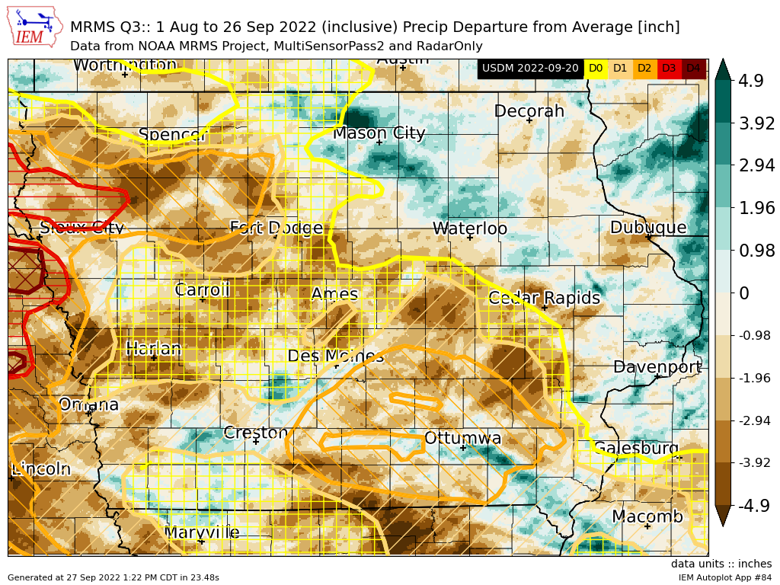
Web Link #84

Slide 33
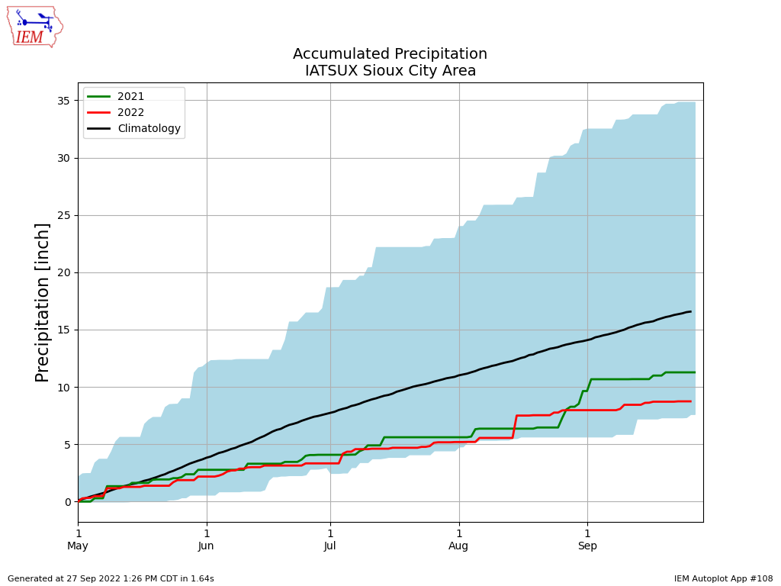
Web Link #108

Slide 34
Some Weather Variables to Monitor
Growing Degree Days
Temperatures
Soil Moisture/Temperature
Precipitation
Wind

Slide 35
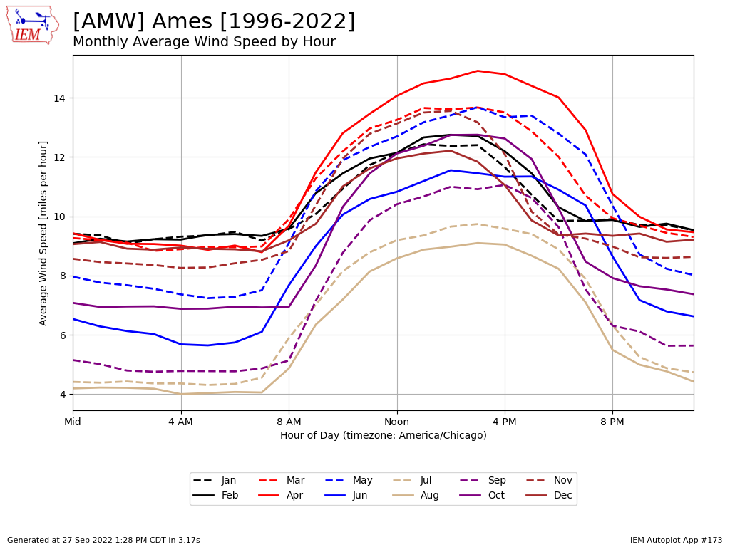
Web Link #173

Slide 36
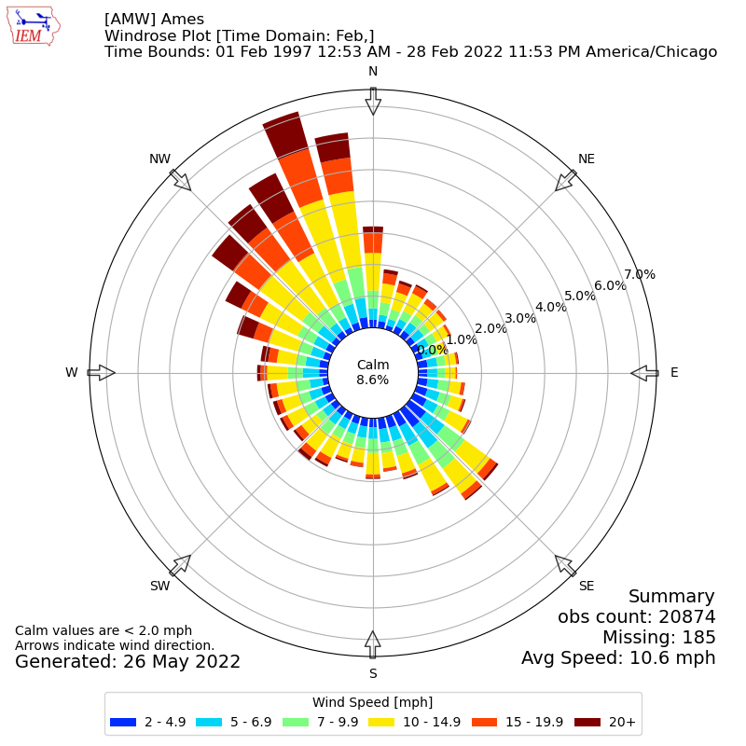
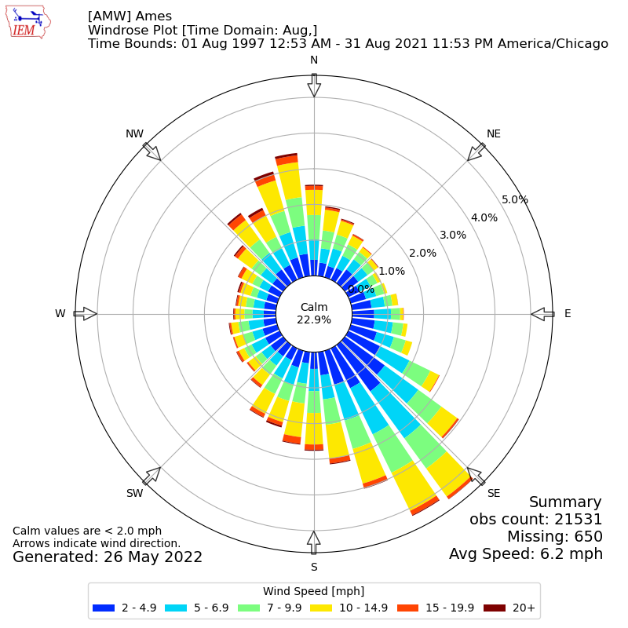
February vs August Wind Rose
Web Link

Slide 37

OK, enough of my rambling…. Questions? https://mesonet.agron.iastate.edu “Info” Tab -> Presentations
Twitter: @akrherz
akrherz@iastate.edu
515-451-9249

